Slide 1

Common sense reasoning for embodied agents
Supervised by Ilaria Tiddi, Stefan Schlobach and Piek Vossen
18/03/2022
Mark Adamik

Slide 2
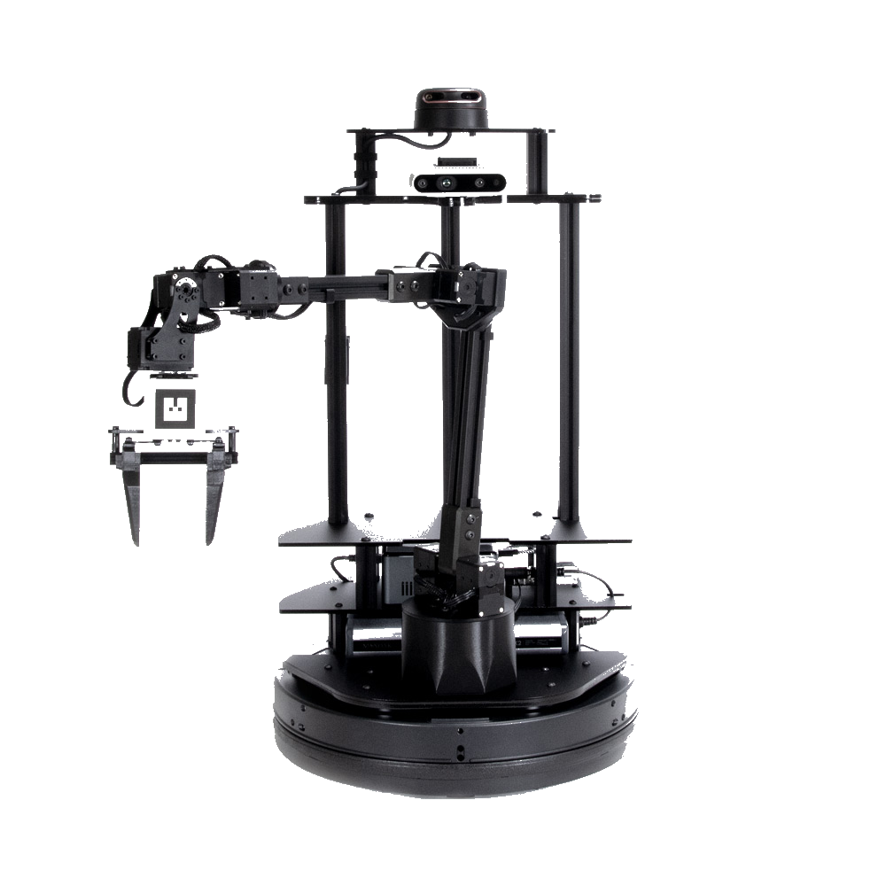
Research questions:
How to identify and extract the bits of relevant common-sense knowledge needed to perform a task?
How to combine this knowledge with the robot’s multi-modal knowledge?
How can the robot use the combined knowledge to frame hypotheses that can make him understand and take action in a given situation?
Current status:
Literature review (problems & challenges)
Hand-crafting knowledge graph of robot components and functions
Creating simulation environment

Slide 3


Background:
Robotics background (both BSc and MSc)
Internship at Honda Research Institute Japan
Working as a student research assistant:
Drone Research Lab (FPGA-based flight controller)
Human-Robot Interaction Lab
About me:
Hungarian
Travelling
Winter bathing & martial arts

